Slide 1
How You Can Use this PPT
This slide deck is intended for a general audience.
You can:
Change order of slides
Remove slides entirely or add your own slides (e.g. state data, etc.)
Reformat slides using your internal templates
Post presentation on your organization’s Web site
Add illustrations or photos that support text IF you hold necessary licenses for their use
Edit text in notes pages to accommodate personal speaking style
You cannot:
Change or update data on these slides. CDC will update data and make revised slides available to you.
Change or edit text or graphics on individual slides. Language in this presentation has been cleared for accuracy and policy compliance.
Extract any of the images to use in other presentations or materials.
For slide updates, please contact Caitlin Wills-Toker (hvj3@cdc.gov).

Slide 2
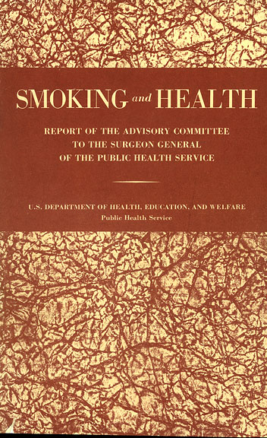
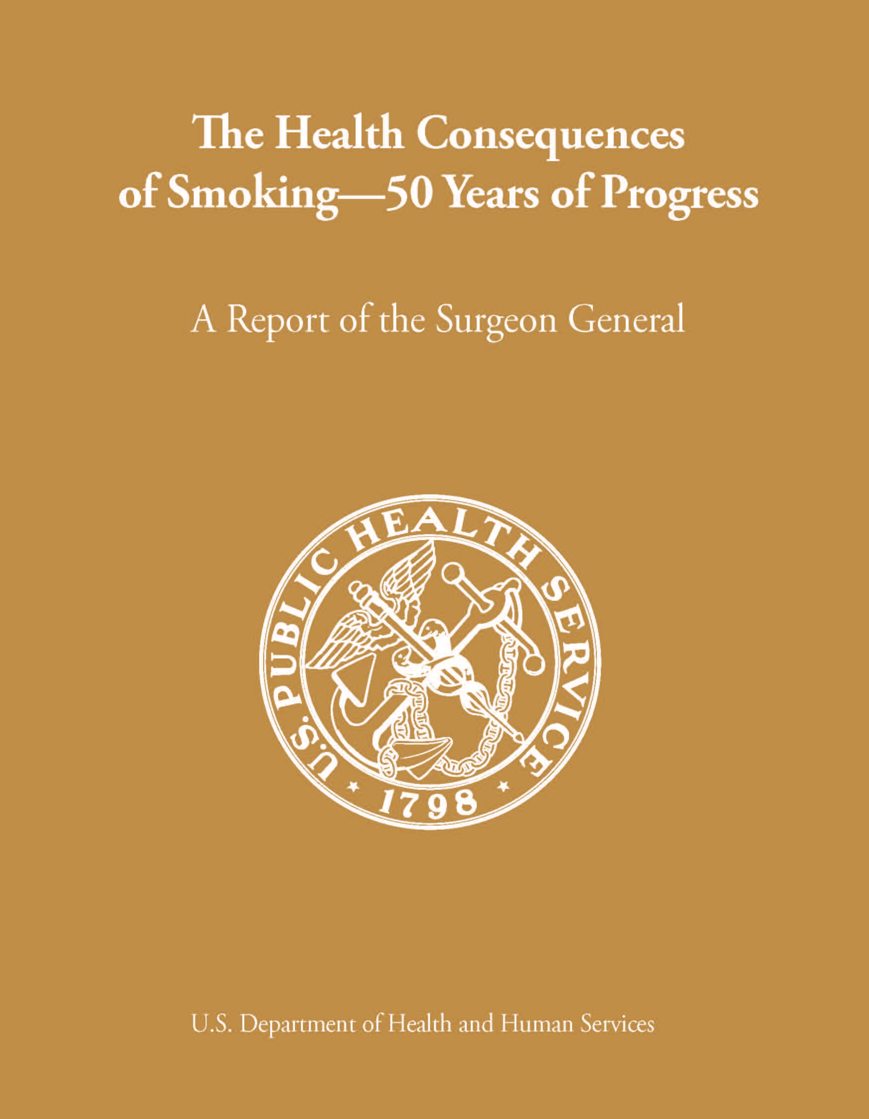
The Health Consequences of Smoking: 50 Years of Progress A Report of the Surgeon General
1964
2014
Notes:
Fifty years ago Dr. Luther Terry shocked the nation when he released the first Surgeon General’s report that linked smoking to lung cancer and heart disease. In January, the 32nd Surgeon General’s Report on smoking and health was released. The new report provides more evidence of the serious damage smoking does to the human body. It also commemorates the anniversary of that first report that laid the foundation for today’s programs to reduce the disease and death caused by smoking.

Slide 3
The Grim Statistics
Between 1964 and 2014:
Over 20 million Americans died because of smoking, including
2.5 million nonsmokers
More than 100,000 babies
Smoking is still the leading cause of preventable disease and death in the United States.
Notes:
Smoking has been called “the persistent epidemic.” Why? Because unlike most health epidemics, smoking and the health effects caused by smoking have been part of the American experience since our earliest beginnings as a nation.
Over time science has shown that people who smoke cigarettes are much more likely to develop – and die from – certain diseases than people who don’t smoke. And despite Dr. Terry’s warning, more than 20 million Americans have died from smoking since the that first report in 1964.
Most of these deaths were of adults with a history of smoking but two and a half million were of nonsmokers who died because they breathed air that was polluted by other people’s cigarette smoke.
More than 100,000 of the smoking-related deaths were of babies who died from Sudden Infant Death Syndrome or other health conditions caused by parental smoking, particularly by the mother.
Despite these sad and sobering numbers, smoking is still the leading cause of preventable disease and death in the nation.

Slide 4
What We’ve Learned
The Killer Cigarette
Smoking risks are more deadly than 50 years ago.
Smokers inhale over 7,000 chemical compounds.
At least 70 CAUSE CANCER.
Notes:
The tobacco industry is largely to blame for those 20 million deaths. Tobacco companies have spent billions of dollars refining and marketing the cigarette. As a result, cigarettes have become more deadly and more addictive over these past 50 years.
The danger of smoking comes from inhaling chemical compounds, some in the tobacco and some that are created when tobacco is burned. The process used to make modern cigarettes includes the use of many harmful chemicals.
In all, scientists have identified more than 7,000 chemicals and chemical compounds in tobacco smoke. At least 70 of them are known to cause cancer.
Some of those chemicals speed and enhance the absorption of nicotine – which is the primary agent in tobacco that causes addiction.

Slide 5
What We’ve Learned
The Killer Cigarette
Smoking causes disease in nearly every organ.
Secondhand smoke kills more than 41,000 nonsmokers every year.
There is no safe level of SHS exposure and NO SAFE CIGARETTE.
Notes:
The reason cigarette smoking is so deadly is that it causes disease in nearly every organ of the body.
Being around an active smoker also presents a significant health risk to those who do not smoke. Why? Secondhand smoke contains the same toxins that active smokers inhale and it kills more than 41 thousand nonsmokers a year in this country.
The science in 50 years of Surgeon General’s Reports has also removed notion that there might be such a thing as a “safe” cigarette. All cigarettes are harmful, and any exposure to tobacco smoke can cause both immediate and long-term damage to the body. Bottom line: There is no safe level of exposure to tobacco smoke, and there is no safe cigarette!

Slide 6
21st Century Tobacco Use
Between 2010 and 2014 smoking caused
Nearly half a million premature deaths a year
More than 87% of all lung cancer deaths
61% of all pulmonary deaths
32% of all coronary deaths
Notes:
One look at more recent data makes the case even more clearly:
Between 2010 and 2014, smoking was responsible for approximately 480,000 premature deaths every year among Americans 35 years of age and older.
Smoking was responsible for nearly 90% of all lung cancer deaths; for 61 % of all pulmonary deaths and for 32% of all coronary deaths in this country.

Slide 7

Smoking and Children
Today about half of all children 3-18 years of age are exposed regularly to cigarette smoke.
Every day over 3,200 kids try their first cigarette and another 2,100 youth and young adults become daily smokers.
Nearly 9 out of 10 smokers started before age 18.
Photo credit: Trinketsandtrash.org
Notes:
Adults are not the only people who suffer because of smoking. Today, about half of all the children between 3 and 18 years old in this country are exposed to cigarette smoke regularly, either at home or in places that still allow smoking.
For decades the tobacco industry has been encouraging children to start smoking by promoting images that make smoking look appealing. Even though the tobacco settlement eliminated promotions and sponsorship of events frequented by children, smoking images are still highly visible in our society. They are found in movies and on TV, in video games, online, in retail advertising and in venues designed for young adults.
Because of tobacco industry marketing and other influences, more than 3,200 children under18 smoke their first cigarette every day. And another 2,100 youth and young adults go from occasional smoking to daily smoking. This is a very important target zone for the tobacco industry. In fact, nearly 9 out of 10 smokers start before the age of 18 – and 20 percent of those smoked their first cigarette before age 13.
And there is another reason why the industry wants to make children and young people their prime target: young people can become addicted more quickly than adults. If they have not started smoking by age 26, there is almost no chance they ever will.

Slide 8
Smoking and Children
Every adult who dies early because of smoking is replaced by two new young smokers.
If they keep smoking, at least one of the two will also die early from smoking.
Notes:
The new Surgeon General’s Report finds that the tobacco industry has used aggressive and deceitful marketing strategies to sell their products. Tobacco companies continue trying to reach youth with new products and appealing images. And they have a history of misleading the public about the dangers of smoking.
Every smoker who dies early is replaced by two new, young smokers.
And here is what that means for those young people: If current risk holds, one of those two will also die early from smoking.

Slide 9
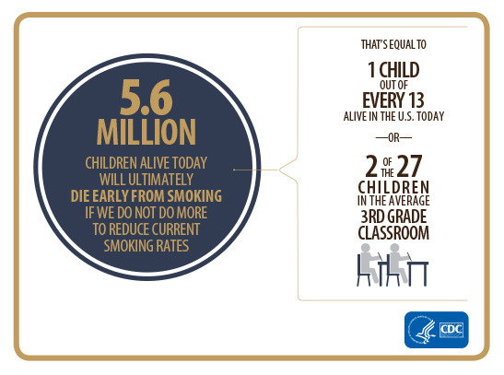
Smoking and Children
Notes:
Lets look at those two children from a broader perspective. What this means is that 5.6 million children alive today will ultimately die early from smoking if we do not do more to reduce current smoking rates.
In everyday terms: that’s equal to 1 child out of every 13 alive in the U.S. today; or, 2 of the 26 children in the average 3rd grade classroom; or 4 out of the 50 riders on the average school bus.
For any other consumer product, these would be intolerable odds for our children. But that is the reality of what our young people are facing if we don’t end this preventable epidemic.

Slide 10
The costs of smoking
Annual smoking costs are more than $289 billion.
We spend at least $132 billion in yearly medical care for adults.
We lose at least $157 billion yearly in productivity costs when smokers get sick and die early.
Notes:
Besides the human costs, there are very steep economic costs from smoking.
The annual price tag for tobacco use in this country is approaching 300 billion dollars.
Productivity losses when smokers get sick and die cost our economy at least 156 billion dollars a year.
And we spend another 130 billion dollars a year for medical treatment for adults suffering from smoking-related illness.
That figure does not include medical care for babies born prematurely or children who have respiratory infections or other health problems from exposure to secondhand smoke.

Slide 11
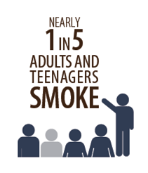
The Power of Nicotine Addiction
Nicotine is the primary addicting drug in cigarettes.
Nicotine keeps people smoking longer and that causes more damage to the body.
Nicotine patches, gum, and lozenges are safe when used as directed.
Notes:
The costs of smoking don’t stop with our economy. Individuals and families also pay a heavy price. So why do people keep doing it, when it’s so expensive and so dangerous? Simply put, smoking is an addiction – and it’s the nicotine in tobacco that causes the addiction.
Today’s cigarettes are probably more addictive than those of half a century ago. It takes only 10 seconds for the nicotine in one puff of cigarette smoke to reach the brain. This rapid delivery of nicotine from the lungs to the brain is one of the reasons that cigarettes are so addictive.
Over time, nicotine changes brain cells. When smokers try to quit, these brain changes cause strong cravings for more nicotine. The biggest health risk from nicotine is that it keeps people smoking longer, and that causes more damage to the body.
Patches, gum, and lozenges deliver nicotine more slowly and help people break free of nicotine addiction. They are safe to use and have proved to be effective in helping people to quit smoking.

Slide 12
Nicotine
Nicotine is the primary addicting drug in cigarettes.
It can raise heart rate and blood pressure.
It can result in premature births and low birth weight babies in women who smoke during pregnancy.
It can be harmful to developing brains.
Notes:
Nicotine is the primary drug in cigarettes that causes addiction.
It also has other health effects.
When nicotine is rapidly delivered by cigarettes, it can raise the heart rate and blood pressure, and can narrow arteries around the heart.
It can result in premature births and low birth weight babies in women who smoke during pregnancy.
Nicotine can also be harmful to developing brains and should not be used by children and adolescents.

Slide 13
Smoking and Lung Cancer
Today’s smokers are more likely to develop lung cancer than smokers 50 years ago.
Lung cancer is the #1 cause of cancer death for men and women.
Nearly 9 out of 10 lung cancers are caused by smoking.
Notes:
In addition to being more addictive, cigarettes have also become more deadly over time.
Between 1959 and 2010, lung cancer risk for smokers rose dramatically. The risk for lung cancer for men who smoked doubled in that time – and the risk for women who smoked was nearly 10 times higher in 2010 than it was in 1959.
Today, lung cancer is the number-one cause of cancer death for both men and women. Nearly 9 out of 10 lung cancers are caused by smoking.
Evidence suggests that changes in how cigarettes are made and the chemicals they contain may explain the increase in lung cancer risk for current smokers. One possible factor for these higher rates is that the filters and vent holes in most modern cigarettes may lead smokers to inhale more deeply, thereby pulling dangerous chemicals farther into their lungs.

Slide 14
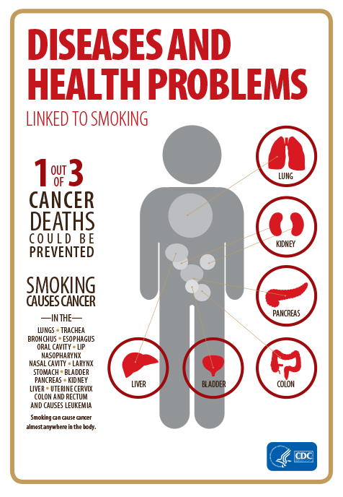
Smoking – The Cancer Trigger
Smoking is now known to cause
13 different types of cancer—
almost everywhere in the body.
1 out of 3 U.S. cancer deaths are tobacco-related.
Notes:
Lung cancer is not the only cancer known to be caused by smoking. In fact, today we know that smoking causes cancer almost anywhere in the body.
When you smoke, chemicals immediately cause damage to the cells in your body. Over time these damaged cells grow uncontrollably in the body. These cells grow into tumors that damage organs and can spread to other parts of the body. Nearly all lung cancer – the number-one cancer killer of both men and women – is caused by smoking.
If no one in the United States smoked, we could prevent one out of three cancer deaths.

Slide 15

New Cancer Findings
TWO more cancers are caused by smoking:
Liver cancer
Colorectal cancer – the second deadliest behind lung cancer
SMOKING keeps cancer treatments from working as well as they should.
Notes:
The 2014 Surgeon General’s Report highlighted more bad news about how smoking affects the body with findings that link smoking to two additional cancers. The evidence is now conclusive that smoking causes both liver cancer and colorectal cancer. Colorectal cancer is the second deadliest cancer after lung cancer.
Smoking keeps cancer treatments from working as well as they should. Cancer patients and survivors who continue to smoke are more likely to die from their original cancer, or secondary cancers, or other secondary medical conditions than are former smokers or people who have never smoked.

Slide 16
Smoking – The Breath Blocker
COPD rates have risen steadily since 1964.
Nearly 8 out of 10 COPD deaths are from smoking.
COPD patients have higher risk for lung cancer and heart disease.
Women who smoke are now dying from COPD in the same numbers as men who smoke.
Notes:
COPD is the third largest cause of death in the United States. Nearly 8 of 10 COPD deaths are due to smoking.
Over time, COPD causes oxygen levels in the body to drop. People with COPD are at high risk for many other serious diseases, including lung cancer and heart disease.
Findings from the 2014 report indicate that women are particularly vulnerable. Women who smoke are now dying from COPD at similar rates as men who smoke, and they appear to be more susceptible to developing severe COPD at younger ages.

Slide 17
Smoking – The Breath Blocker
Chronic Obstructive Pulmonary Disease (COPD)
Smoking causes most cases of COPD.
There is NO CURE for COPD
Notes:
Smoking is also a major cause of serious respiratory disease. One of the most serious is chronic obstructive pulmonary disease, or COPD.
COPD includes several lung diseases such as emphysema and chronic bronchitis. People with COPD suffer from:
shortness of breath,
coughing,
air trapped in their lungs,
swollen airways, and
scar tissue.
COPD has no cure.

Slide 18
Smoking – The Breath Blocker
Other respiratory diseases
Smokers have a higher risk of getting and dying from TB.
Youth who smoke may be more likely to develop asthma.
Children exposed to SHS have more respiratory infections.
Notes:
Tuberculosis is a common infection worldwide that usually attacks the lungs. Advances in public health have made TB far less common in the U.S. than it once was. There is now enough evidence to conclude that smoking increases a person’s risk of getting TB and dying from it.
Asthma is a respiratory disease that is quite too common. More than 11% of high school students in the United States have asthma, and evidence suggests that young people who smoke are more likely to develop asthma. And it’s not just smokers who are at risk; breathing someone else’s smoke also triggers asthma attacks in nonsmokers.
We also know that children exposed to secondhand smoke also have more respiratory infections than children who are not exposed.

Slide 19
Smoking – The Heart Stopper
Cardiovascular Disease (CVD)
CVD is the biggest killer in the U.S.
It causes more than 800,000 deaths every year.
Smoking is a major cause of CVD.
SHS increases the risk for heart attack or stroke, even for nonsmokers.
Notes:
When we think of diseases caused by smoking, we most often think of respiratory disease and cancer. But there is an even bigger smoking-related killer. It is cardiovascular disease.
Cardiovascular disease is the single largest cause of all deaths in the United States. It kills more than 800,000 people a year. Smoking is a major cause of cardiovascular disease, and causes 240,ooo of the.
More than 16 million Americans have heart disease. Almost 8 million already have had a heart attack and 7 million have had a stroke.
Even exposure to secondhand smoke can cause a heart attack or stroke. More than 33,000 nonsmokers die every year in the United States from heart disease caused by secondhand smoke.

Slide 20

Cardiovascular disease includes:
Coronary heart disease
High blood pressure
Heart attack
Stroke
Abdominal aortic aneurysm
Peripheral arterial disease
Notes:
Cardiovascular disease includes several conditions:
Coronary heart disease and peripheral arterial disease occur when arteries become blocked or narrow;
Stroke and heart attack occur when normal blood flow to the brain or heart is interrupted;
High blood pressure, or hypertension, is when the force of the blood against the artery walls is higher than it should be; and
Triple A, or abdominal aortic aneurysm is when a bulge or weak area occurs in the main artery that feeds organs in the abdomen.

Slide 21
Smoking – The Heart Stopper
Smoking causes cells lining veins and arteries to swell.
Narrower arteries mean reduced blood flow to the heart, brain, and organs.
Clots can block narrowed arteries, causing heart attack, stroke, and even sudden death.
Even occasional smoking damages blood vessels.
Notes:
Most of the conditions that make up cardiovascular disease are caused or made worse by smoking.
Chemicals in cigarette smoke cause the cells that line blood vessels to swell, and the opening in blood vessels to become more narrow. The longer you smoke, and the more cigarettes you smoke, the more serious the damage.
But even new smokers, or people who only smoke a few cigarettes a day, are at risk. Autopsy studies have shown that the early signs of cardiovascular disease appear in young adults who began smoking as teenagers.

Slide 22
Smoking & Reproduction
Smoking during pregnancy endangers moms and babies.
More than 400,000 U.S. babies are exposed to chemicals in cigarette smoke before birth.
Babies of smoking mothers have higher risk of SIDS.
Mothers who smoke in early pregnancy are more likely to have babies with cleft lip or cleft palate.
Notes:
Physical harm from smoking can begin even earlier than the teen years – it can begin in the womb.
Pregnant women who smoke endanger their unborn babies, as well as their own health.
Every year more than 400,000 babies born in the United States are exposed to chemicals in cigarette smoke before birth because their mothers smoke or are exposed to secondhand smoke during pregnancy.
Babies whose mothers smoked during pregnancy – and those who are exposed to secondhand smoke after birth – are more likely to die of SIDS, or Sudden Infant Death Syndrome.
Since 1965, 100,000 babies have died of SIDS and other health conditions caused by exposure to chemicals in cigarette smoke.
Smoking during pregnancy can also cause birth defects, including cleft lips and cleft palates – conditions in which the lip or palate fails to form completely.
Both conditions interfere with an infant’s ability to eat properly, and both must be corrected with surgery.

Slide 23

Smoking and Reproduction
Smoking can cause ectopic pregnancy, which almost always causes the fetus to die.
Other smoking complications
can include:
early delivery
low birth weight
Notes:
Smoking can cause ectopic pregnancy. This is a condition in which the fertilized egg fails to move into the uterus and instead attaches in the fallopian tube or to other organs outside the womb. Ectopic pregnancy almost always causes the fetus to die and poses a serious risk to the health of the mother.
Also, mothers who smoke during pregnancy are more likely to deliver their babies early. Preterm delivery is a leading cause of death, disability, and disease among newborns.
Mothers who smoke during pregnancy are also more likely to deliver babies with low birth weight, even if the babies are full term.

Slide 24

Smoking and Reproduction
Smoking also causes reproductive issues for men:
Smoking can cause erectile dysfunction (ED).
Smoking damages DNA in sperm.
Notes:
Of course, it’s not just women who raise the reproductive risk by smoking. Men can also contribute to the risk.
In the United States, 18 million men over age 20 suffer from erectile dysfunction, or ED. A man with ED can’t have and maintain an erection that is adequate for satisfactory sexual performance, which can affect reproduction.
Recent evidence concludes that smoking is a cause of ED. Cigarette smoke alters blood flow necessary for an erection, and smoking interferes with the healthy function of blood vessels in erectile tissue.
Men also need healthy sperm for fertility. Smoking damages DNA in sperm, which can lead to infertility or early fetal death.

Slide 25
Smoking and Diabetes
Diabetes is the 7th leading cause of death in the U.S.
Smoking causes type 2 diabetes.
Smokers are 30-40% more likely to develop type 2 diabetes than nonsmokers.
Notes:
In addition to affecting reproduction, smoking interferes with proper metabolic function in the body.
Diabetes – a disease that causes blood sugar levels in the body to be too high – is a growing health crisis around the world. In the United States, more than 25 million adults suffer from diabetes.
We now know that smoking causes type 2 diabetes, also known as adult-onset diabetes. Smokers are 30% to 40% more likely to develop type 2 diabetes than nonsmokers.
The more cigarettes an individual smokes, the higher the risk for diabetes.

Slide 26

Smoking and Diabetes
Diabetic smokers:
Have difficulty regulating insulin levels.
Have higher risk of heart disease, blindness, kidney failure, and nerve and blood vessel damage to feet and legs.
Notes:
A person with diabetes (Type 1 and Type 2) who smokes is more likely to have trouble regulating insulin and controlling the disease than a nonsmoker with diabetes.
Diabetes can cause serious health problems, including heart disease, blindness, kidney failure, and nerve and blood vessel damage of the feet and legs, which can lead to amputation.
Smokers with diabetes are more likely to have all of these conditions than are nonsmokers with diabetes.

Slide 27

Smoking and Eye Disease
Smoking causes serious eye disease, including:
Age-related macular degeneration (AMD)
Cataracts
These diseases are the most common causes of blindness.
Notes:
We have also learned that smoking causes age-related macular degeneration and cataracts, both of which are serious eye diseases. They are major causes of blindness in adults.
Chemicals in cigarette smoke restrict blood flow and damage delicate cells in the eye. Cataracts can be corrected with surgery but AMD often leads to permanent blindness.

Slide 28
Smokers are sicker longer and more often
More than 16 million Americans suffer from at least one disease caused by smoking.
Smokers have more lung infections than nonsmokers.
Smokers are admitted to hospitals more often than nonsmokers.
Smokers miss more work than nonsmokers.
Notes:
The immune system is the body’s way of protecting itself from infection and disease. Smoking compromises the immune system and can make the body less successful at fighting disease.
In fact, smokers generally are much less healthy than nonsmokers. Their overall health is worse, they need to go to the doctor more often, and they are admitted to the hospital more often. Smokers also miss more work than do nonsmokers. This costs American businesses, and American workers who smoke, billions of dollars every year.

Slide 29
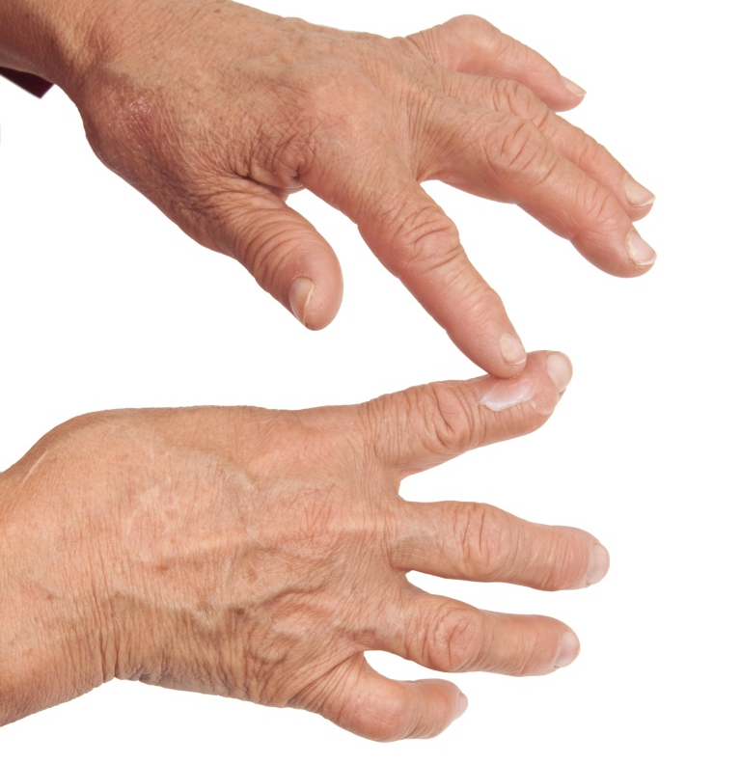
Smoking and the Immune System
Smoking harms the immune system and causes autoimmune disorders.
Smoking is a cause of rheumatoid arthritis (RA).
RA treatment can be less effective for smokers.
Notes:
Smoking can not only weaken the immune system but also causes autoimmune disorders. Autoimmune disorders occur when the immune system attacks the body’s healthy cells.
For example, in rheumatoid arthritis, or RA, the immune system attacks the joints and tissue around the joints, causing swelling and pain. As a result, people with RA have a harder time getting around and doing normal daily activities.
We now know that RA can be caused by smoking, and smoking makes some RA treatments less effective. More women have RA than men.

Slide 30
Smoking Today – The Persistent Epidemic
Cigarettes cause almost all tobacco-related disease and death.
Smoking claims nearly 500,000 lives every year.
More than 16 million people have at least one smoking-related disease.
88 million Americans continue to be exposed to SHS.
Notes:
With all the serious health effects it causes, it is no wonder that smoking has been the number-one cause of preventable disease and death in this country for decades. Although we have cut smoking rates in half since 1964, the current rate of progress is not good enough.
Smoking still claims nearly 500,000 lives each year in this country.
More than 16 million people already have at least one disease from smoking.
At least 88 million Americans continue to be exposed to the dangerous chemicals in secondhand smoke.
While smokeless tobacco is also dangerous to health, the death and disease from tobacco use that continues to plague this nation is overwhelmingly caused by cigarettes and other burned tobacco products.

Slide 31
Smoking Today – The Persistent Epidemic
Lower smoking rates have saved 8 million lives and added about three years to average life expectancy.
50 years after the first SG report, 18% of Americans smoke compared to 43% in 1965.
Today 42 million adults and 3 million middle and high school students are smokers.
We have made progress, but there is still so much more to do.
Notes:
In the last half century, lower smoking rates have saved about 8 million lives in this country. During that time, average life expectancy has increased by about 10 years, and a third of that increase is because of changes in tobacco use.
In 1964, 43% of American adults were smokers. Today, that figure has dropped to 18%.
Smoking rates among youth have also dropped by more than half.
But fifty years after that first Surgeon General’s report, 18% of Americans still smoke. That’s 45 million adults and youth.

Slide 32

Saving Millions of Lives – Doing Much More
We know what works to lower smoking rates:
Smokefree policies in public places
Make smoking the exception – not the norm
Easy-to-get affordable smoking cessation treatments
Notes:
The good news is that we know what to do. We have the tools at our disposal. They are the same ones that have worked so well for us these past 50 years and some new and refined ones as well. CDC’s Best Practices provides in-depth information on proven strategies that reduce tobacco use.
Smokers who want to quit should have easy access to affordable smoking cessation treatments. At a minimum, everyone has access to free counseling and support through the quitline service at 1-800-QUIT-NOW.
We need to expand the number of states and communities with comprehensive smokefree policies in public places. They protect nonsmokers and make smoking the exception, not the norm.

Slide 33

Cessation – Lifeline to a Tobacco-Free Life
Most smokers want to quit and half already have.
Cessation therapies improve your chances of quitting successfully.
Talk to your doctor, and call 1-800-QUIT-NOW or go to http://www.SmokeFree.gov for free help.
Notes:
Prevention is critical, and we need to continue focusing on keeping young people from starting to smoke in the first place. We cannot end the epidemic as long as there is a continuing pipeline of new smokers.
But we also cannot ignore the 42 million American adults who still smoke. The vast majority of them want to quit and we need to help them do that.
Because quitting is hard, and usually takes several serious attempts, some smokers think they can’t quit. But that’s not true. Half of this country’s smokers have already quit and success rates are higher today than ever.
Increasing insurance coverage of cessation treatment will help – and engaging the medical community to encourage patients to quit will also help.
The bottom line – we need to make it as easy to get affordable cessation treatment as it is to buy a pack of cigarettes.

Slide 34
Saving Millions of Lives – Doing Much More
We know what works to lower smoking rates:
Higher prices on cigarettes and other tobacco products
Well-funded, continuous mass media campaigns about the dangers of smoking
State and community outreach, educational and public health programs
Notes:
We need to raise prices on cigarettes. Many countries and some U.S. cities have successfully raised prices to ten dollars a pack. Higher prices are very effective at discouraging young people from starting in the first place. High prices also encourage adult smokers to quit.
We need to continue high-impact media campaigns that talk bluntly about the dangers of smoking and that tell people about resources to help them quit.
We need more state and community programs that integrate tobacco control into medical, retail, education, and public health environments. These programs reach people who might not otherwise be exposed to tobacco control efforts.

Slide 35
We Can Be Tobacco-Free
The time is NOW to begin a tobacco-free future.
We can break the cycle of sickness, disability and death caused by smoking.
We can reduce the disease and death caused by smoking until the scourge of the tobacco use epidemic becomes a minor public health nuisance.
Notes:
Although our progress over the past 50 years has been nothing short of astounding, there is still an urgency about our work. Millions of children and adults addicted to tobacco products need help in getting free of this problem and to live healthier lives.
The time is NOW to begin a tobacco-free future for our citizens.
We can break the cycle of sickness, disability and death caused by smoking.
We can save billions of dollars and millions of lives in the coming decades – and prevent early death for 5.6 million of today’s children.

Slide 36
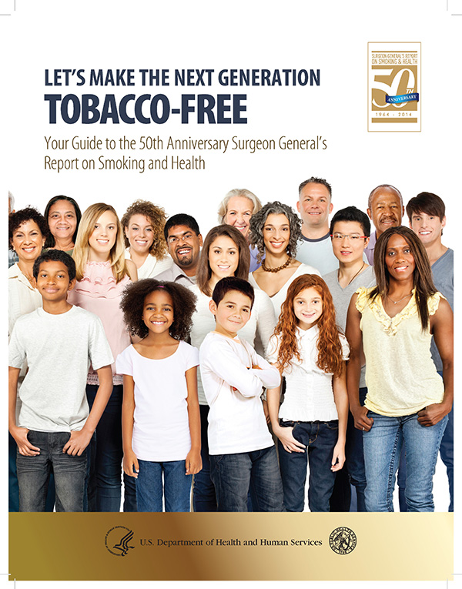
We Can Be Tobacco-Free

Slide 37
Resources
http://www.BeTobaccoFree.gov - information portal for additional tobacco-related Web sites
http://www.surgeongeneral.gov/initiatives/tobacco/- SGRs, consumer guides, Public Service Announcements
http://www.cdc.gov/tobacco - statistics, reports, plain language products for download and ordering
http://www.smokefree.gov - help for people who want to quit smoking
http://www.cdc.gov/tips - stories of real people dealing with smoking-related diseases and how they quit

